Slide 1

Lecture-9
Recursion - 2
•
Advanced Problems
on
Recursion
Kartik Mathur

Slide 2

Status of HackerBlocks?

Slide 3
3
Any doubts?

Slide 4
4
Inbuilt Sort() Function?

Slide 5
September 23,
2018
<CSTRING>
Inbuilt String Class !
vInitializing a string
Strings(“Hello Cb”);
Char a[]=“Big Bang Theory!”;
String s1(a);
String s2[100]={“apple”,”mango”,”code”};
Cout<<s2[0][1];
char a[ ] string s;
Strcmp();
strcpy();
strlen();

Slide 6
September 23,
2018
Warm Up?
v Multiply two numbers X and Y without using
*(Multiply ) operator, using recursion ?
vConvert String to an integer ?
“12345” to 12345.
vFind ALL7’s and also store their indices,
instead of just printing them, store them as
well.

Slide 7
September
23,
7
2018
Find all subsequence of a string
“abc” – “”, “a”, “b”, “c”, “ab”, “ac”, “bc”, “abc”
Before we think about recursive solution lets look at
few things:
We need this function to return an array of
strings.
But in C++ we know we cannot return array as
this would be address of local variable.
Instead we can pass it as argument and expect
it to fill this array with the strings.
We also need to know how many strings in this
array were filled by the function so that we can
iterate over it and print it.

Slide 8
September 23,
2018
Lets find recursion in it.
S(“”) – [“”]
S(“c”) – [“”, “c”]
S(“bc”) – [“”, “c”, “b”, “bc”]
S(“abc”) – [“”, “c”, “b”, “bc”, “a”, “ac”,
“ab”, “abc”]
Figured out?
S(“abc”) = S(“bc”) + copy of all S(“bc”) with
‘a’ prefixed.

Slide 9
9
Time to code.

Slide 10
September
23,
10
2018
Permutations of a String.

Slide 11
September
23,
11
2018
What if the problem statement
changed to just save all
permutations instead of printing ?

Slide 12
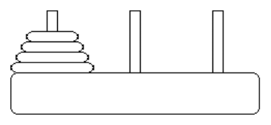
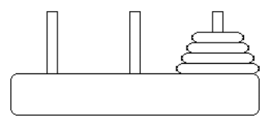
September 23,
2018
Towers of Hanoi !
Initial State
Final State

Slide 13
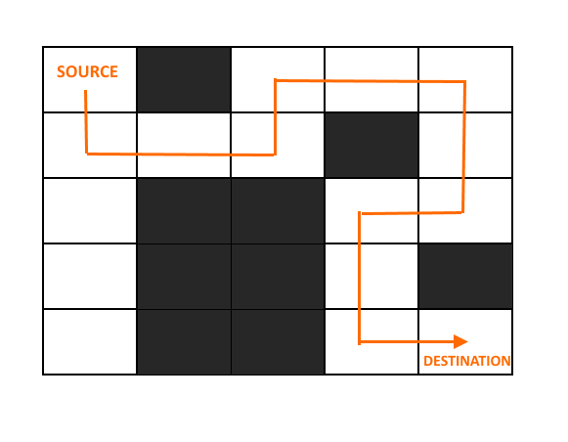
September
23,
13
2018
Rat in a Maze Problem

Slide 14
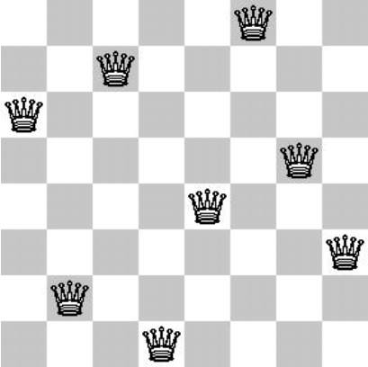
September
23,
14
2018
N – Queens Problem

Slide 15
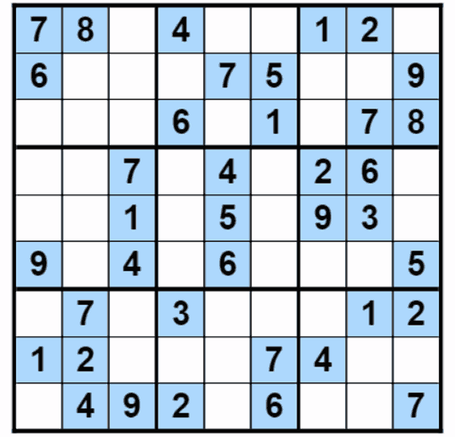
Sudoku Solver
Create a Sudoku Solver and Checker

Slide 16

Sample Input
int mat[9][9] =
{{5,3,0,0,7,0,0,0,0},
{6,0,0,1,9,5,0,0,0},
{0,9,8,0,0,0,0,6,0},
{8,0,0,0,6,0,0,0,3},
{4,0,0,8,0,3,0,0,1},
{7,0,0,0,2,0,0,0,6},
{0,6,0,0,0,0,2,8,0},
{0,0,0,4,1,9,0,0,5},
{0,0,0,0,8,0,0,7,9}};
1
6

Slide 17
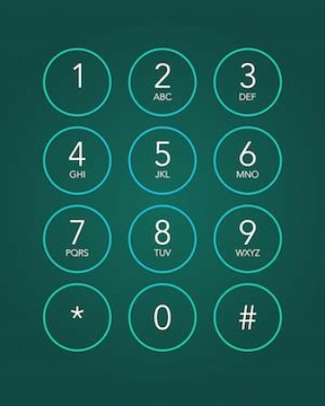
Phone Keypad
1
7

Slide 18
September 23,
2018
N - StairCase ?

Slide 19
Ways in (n*m) empty grid?

Slide 20
Chess E lephant ?

Slide 21
21
Quick Sort - (HomeWork)
Read and implement Quick Sort.

Slide 22
Kartik Mathur

